Slide 1
BMED 4699, Mahdi Al-Husseini Simulating Blood Flow through a Hypothetical Modified Fontan Procedure
Emory Center for Mathematics and Computing in Medicine E(CM)²

Slide 2
Fall Semester Plan
Develop a Fundamental Understanding of Finite Element Methods (FEM) and Review Navier-Stokes Formulations for FEM
Develop MATLAB Pre-Processor and Processor Files that take Patient Specific IVC/SVC/PA Measurements from Dr. Anthony Corno, and output Constructive Geometry Mesh Files
Identify Relevant Boundary Conditions for the Fontan Procedure from the Academic Literature
Develop C++ Navier-Stokes Solver (.edp file) and specify Boundary Conditions in NetGen

Slide 3
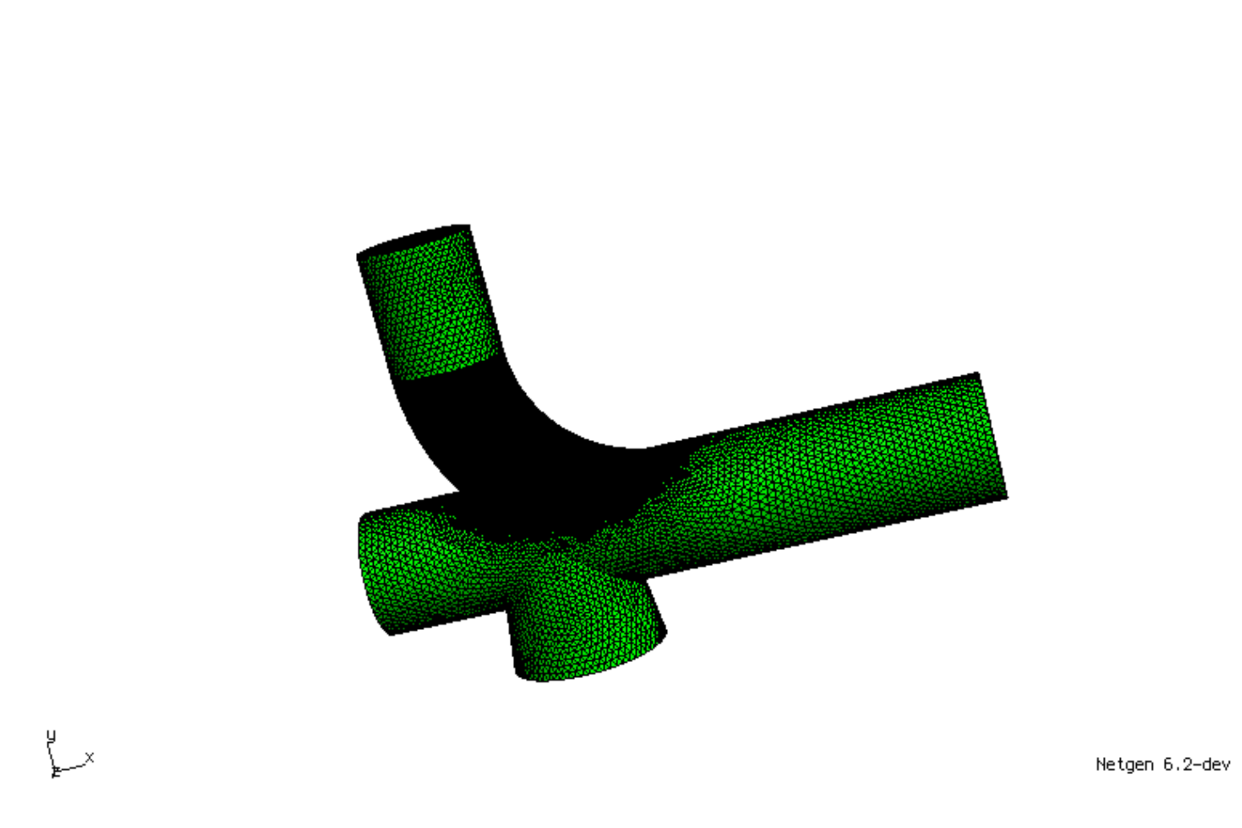
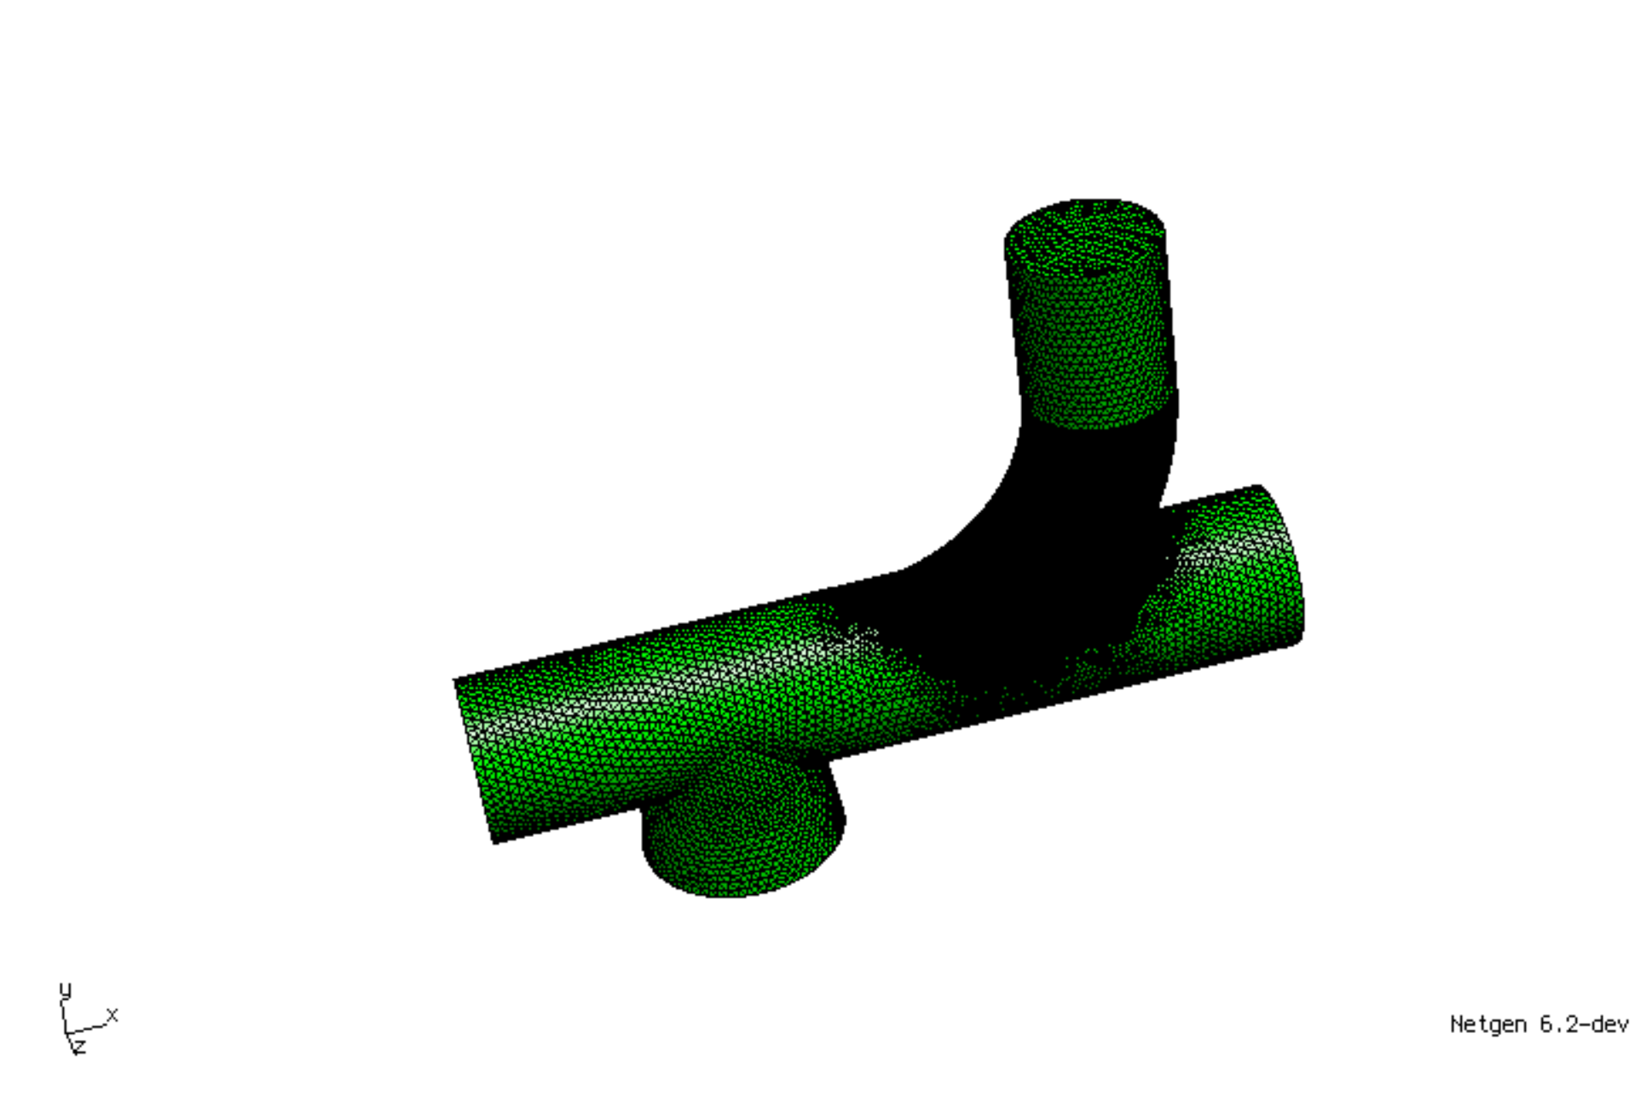
Constructive Geometry Mesh Files developed in MATLAB and visualized in NetGen
Fontan
Modified Fontan

Slide 4
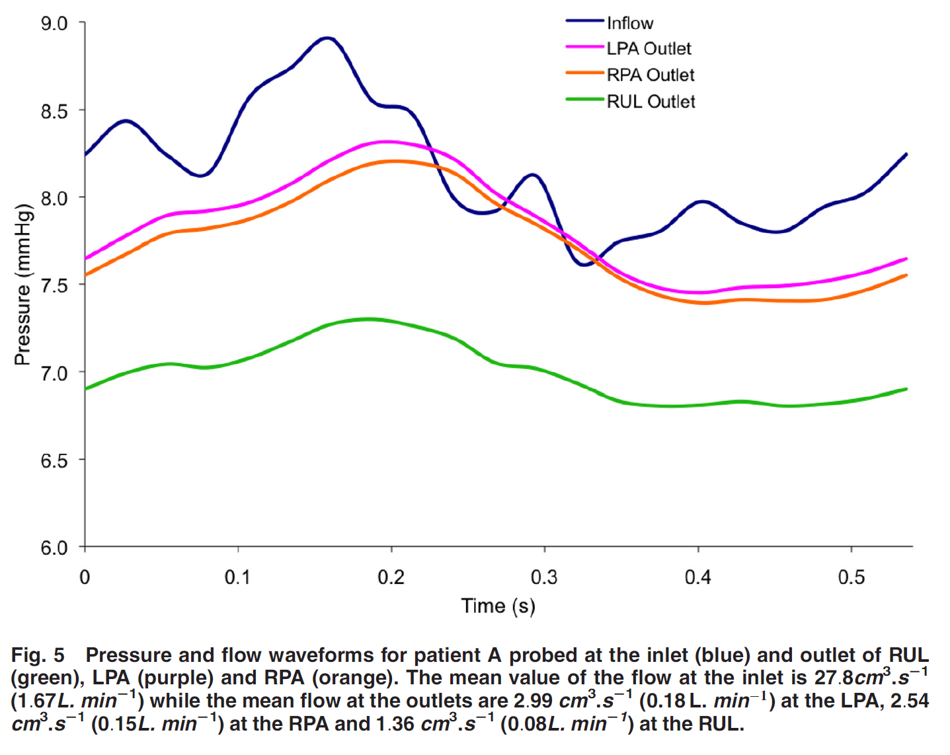
Identified Boundary Conditions of Note
Troianowski, G., Taylor, C. A., Feinstein, J. A., & Vignon-Clementel, I. E. (2011). Three-dimensional simulations in Glenn patients: clinically based boundary conditions, hemodynamic results and sensitivity to input data. Journal of biomechanical engineering, 133(11), 111006.

Slide 5
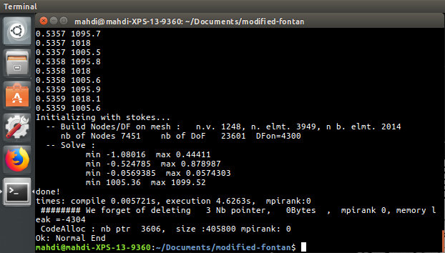
Finite Element Treatment of Navier Stokes

Slide 6
Spring Semester Plan (Looking Forwards)
Finalize C++ Navier-Stokes Solver (.edp file) and specify Boundary Conditions in NetGen
Visualize in ParaView
If Significant Difference Detected between Fontan and Modified Fontan:
Begin Developing Patient-Specific Mesh using CT Scan
Reapply Navier-Stokes Solver to both Models
Write-up and Publish Results

